Slide 1
Load Balancers
Ajay Singh
Vishrut Sharma
Vu Lee

Slide 2
What is Load Balancing
Efficiently distributing incoming network traffic across a group of backend servers (server farm/server pool)
Load balancers route client requests across all servers so that they maximize speed and no server is overworked.
If any server goes down, then load balancers redirect traffic to the other servers
When new servers are added, load balancers automatically start sending them requests.
Notes:
Modern high-traffic websites must serve hundreds of thousands, if not millions, of concurrent requests from users or clients and return the correct text, images, video, or application data, all in a fast and reliable manner. To cost-effectively scale to meet these high volumes, modern computing best practice generally requires adding more servers.

Slide 3
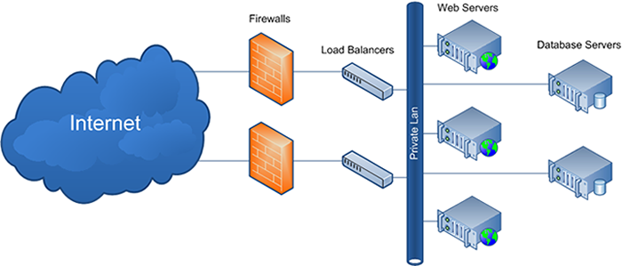
Functions:
Distributes client requests or network load efficiently across multiple servers
Ensures high availability and reliability by sending requests only to servers that are online
Provides the flexibility to add or subtract servers as demand dictates

Slide 4
Advantages of load balancing
Improves performance of each node on the network
Reduces idle time for any request/job
Maximum utilization of resources
Response time becomes shorter
No single point of failure
Scalability: We can increase or decrease the number of servers on the fly without bringing down the application
Notes:
ound Robin – Requests are distributed across the group of servers sequentially.
Least Connections – A new request is sent to the server with the fewest current connections to clients. The relative computing capacity of each server is factored into determining which one has the least connections.
IP Hash – The IP address of the client is used to determine which server receives the request.

Slide 5




Examples
Cisco load balancer
Nginx Plus
Amazon ELB
Citrix load balancer

Slide 6
Software load balancers
Implements a combination of one or more scheduling algorithms
Common algorithms
Round robin scheduling
Least connection first scheduling
Weighted scheduling algorithm
Notes:
Common algorithms used
Round Robin
Least connections
IP Hash

Slide 7
Weighted scheduling algorithm
Work is assigned to a server according to the weight associated with each server
The weight of each server is determined by admins by considering the hardware capabilities of each server.
The load balancer will compute the percentage of traffic to be sent to a particular server according to the weight assigned to it
When to use? :
used when there is a considerable difference between the capabilities and specification of the servers present in the farm or cluster.

Slide 8
Round robin scheduling
Requests are served by the server sequentially one after another
After sending the request to the last server, it starts from the first server again.
This algorithm is used when servers are of equal specification and there not much persistent connections.

Slide 9
Least Common first Scheduling
Requests are served first to the server which is currently handling least number of persistent connections.
All the request related to a session is sent to the same server to maintain the session state and synchronization.
This approach is used when we have session aware write operations in sync with client and the server so that it avoids any inconsistency.

Slide 10
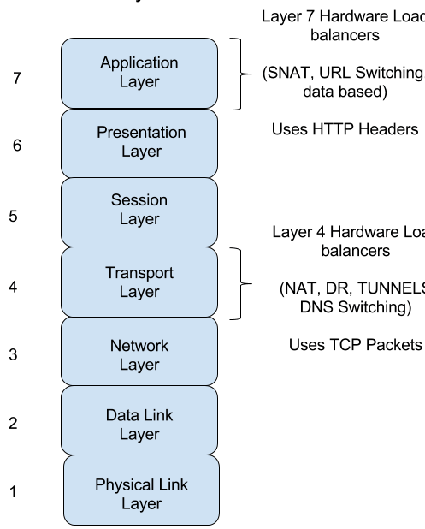
Hardware Load balancers
Load balancing hardware are often referred as specialized routers or switches which are deployed in between the servers and the client
The hardware load balancers are implemented on Layer4 (Transport layer) and Layer7 (Application layer) of OSI model

Slide 11
Layer 4 : Load balancers
Layer 4 : Network address translators : Map between IP and MAC addresses
DNS load balancing: Domain Name Servers are configured to return different IP for different systems . This approach creates a load balancing effect whenever there is a DNS lookup
IP TUNNELING: traffic between the router and the server is routed.
client sends the request to the virtual IP of load balancer which further encapsulates the IP packets, keeps a hash table and distributes it to the different servers as per the configured load balancing technique.
Notes:
Tunnel or a IP tunneling often looks like Direct routing where response is directly sent to client however the traffic between the router and the server can be routed.
In this, client sends the request to the virtual IP of load balancer which further encapsulates the IP packets, keeps a hast table and distributes it to the different servers as per the configured load balancing technique.
When the server is getting back the response, it decapsulates it and send back to the client directly according to the hash table which it has stored. This record is eventually removed from hash table when the connection is closed or there is a timeout.

Slide 12
Layer 7 : Load balancers
This type of load balancers makes the decision according to the actual content of the message (URLs, cookies, scripts) since HTTP exists on the layer7.
These layer7 hardware actually form a ADN (Application delivery network)and they pass-on request to the servers as per the type of the content.

Slide 13
THE END .

